Slide 1
An analysis of mask usage rates on limiting covid-19 death rate
By Zachary Ziman

Slide 2
Data Source
All Data was sourced from The New York Times US Coronavirus Database
The mask use by county and U.S. county data sets were the two utilized for analysis

Slide 3
Analysis Goals
Since the start of the COVID-19 pandemic, masks have been a helpful tool in limiting transmission of COVID-19 and have been encouraged in most public areas around the United States
The goal of this analysis is to determine whether areas with high mask usage experience lower death rates from COVID-19
The findings of this analysis could be useful in the planning of COVID-19 prevention measures

Slide 4
Process
The two datasets were cleaned and filtered individually using Excel
Each dataset was imported into SQL and the key metrics were joined together into one dataset.
The visualizations were created using Tableau

Slide 5
Limitations
This analysis experiences is bias due to the fact that mask usage was collected through self-response
The survey responses can be impacted be response and memory biases which could impact the results

Slide 6
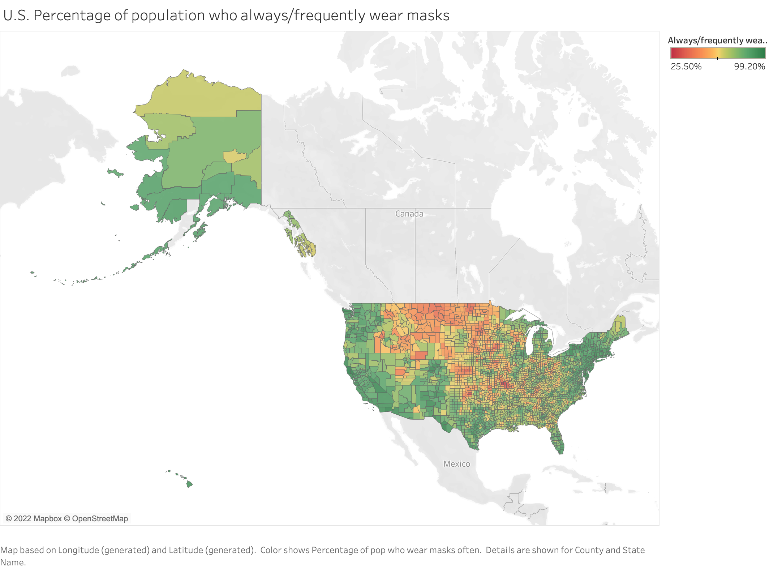
Always/Frequently wear masks
Always/Frequently wear masks

Slide 7
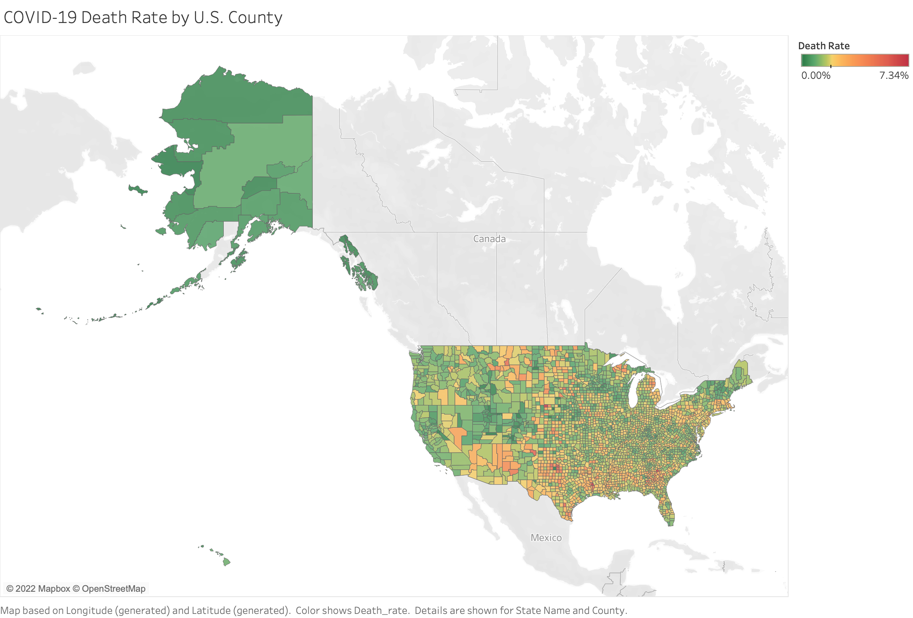

Slide 8
Observations
The Upper mid-west of the United States exhibited a lower frequency of mask-wearing compared to other regions of the United States.
This same area didn’t have a larger COVID-19 death rate compared to areas with higher frequency of mask-wearing

Slide 9
Further Study
Investigation into COVID-19 transmission rates by county compared to their mask-wearing survey responses would be helpful in determining if masks reduce transmission

